Slide 1

ALY6017: COMMUNICATION / VISUAL DATA ANALYSIS
College of Professional Studies, Northeastern University
Prof. Jack Bergerson
Group No.: 4
Group Members:
Sharvil Wadekar
Mohit Kamble
Soham Mane
Jiangyu Qin
01 February 2024

Slide 2

Context
Abstract
Analysis & Findings
Dashboard
Conclusion
References

Slide 3
Abstract
This dataset, which includes New York Police Department arrest statistics, provides insight into crime trends. Analyzing the top ten offenses indicates common criminal activities, which aids law enforcement efforts. Identifying the most common offenses and offender demographics, such as age, reveals patterns in criminal activity. This specialized examination of age-related phenomena informs targeted initiatives, assisting policymakers in tackling specific issues within the jurisdiction. The dataset is an invaluable resource, allowing for a concise yet thorough examination of arrest dynamics, ultimately leading to informed decision-making and improved public safety measures in New York City.

Slide 4
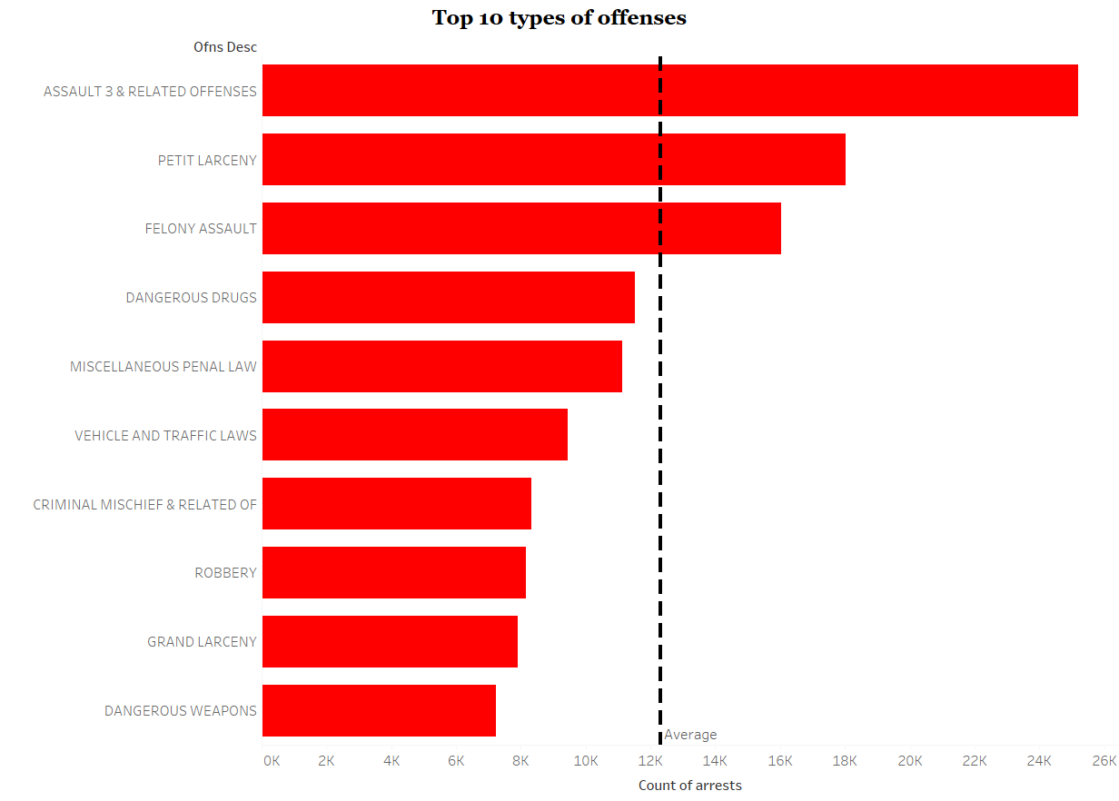
Analysis & Findings
Questions asked about the data
What are the top 10 offenses?
Top offenses: Assault 3, Petit Larceny, Felony Assault.
Drug impact: 11,526 arrests, emphasizing public health and law enforcement efforts. Traffic laws nexus: 9,442 cases, highlighting their role in overall crime rates.

Slide 5
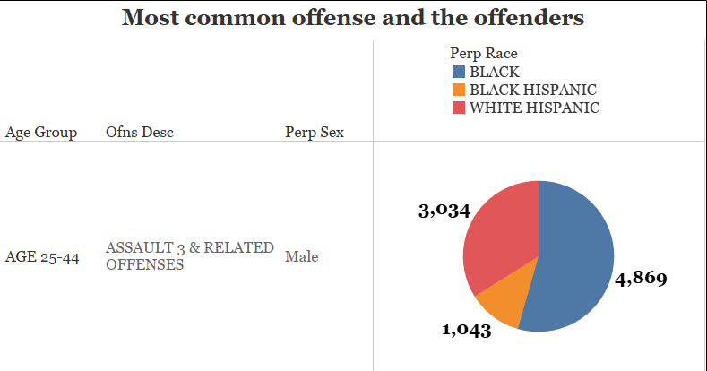
Analysis & Findings
2. What is the most common offense and the most common offenders?
Assaults by males (25-44): Significant cases involving Black Hispanic, White Hispanic, and Black males.
Racial Disparities: Highlighting issues in Assault 3 & Related Offenses for Black and White Hispanic individuals (25-44), prompting targeted interventions and law enforcement strategies.

Slide 6
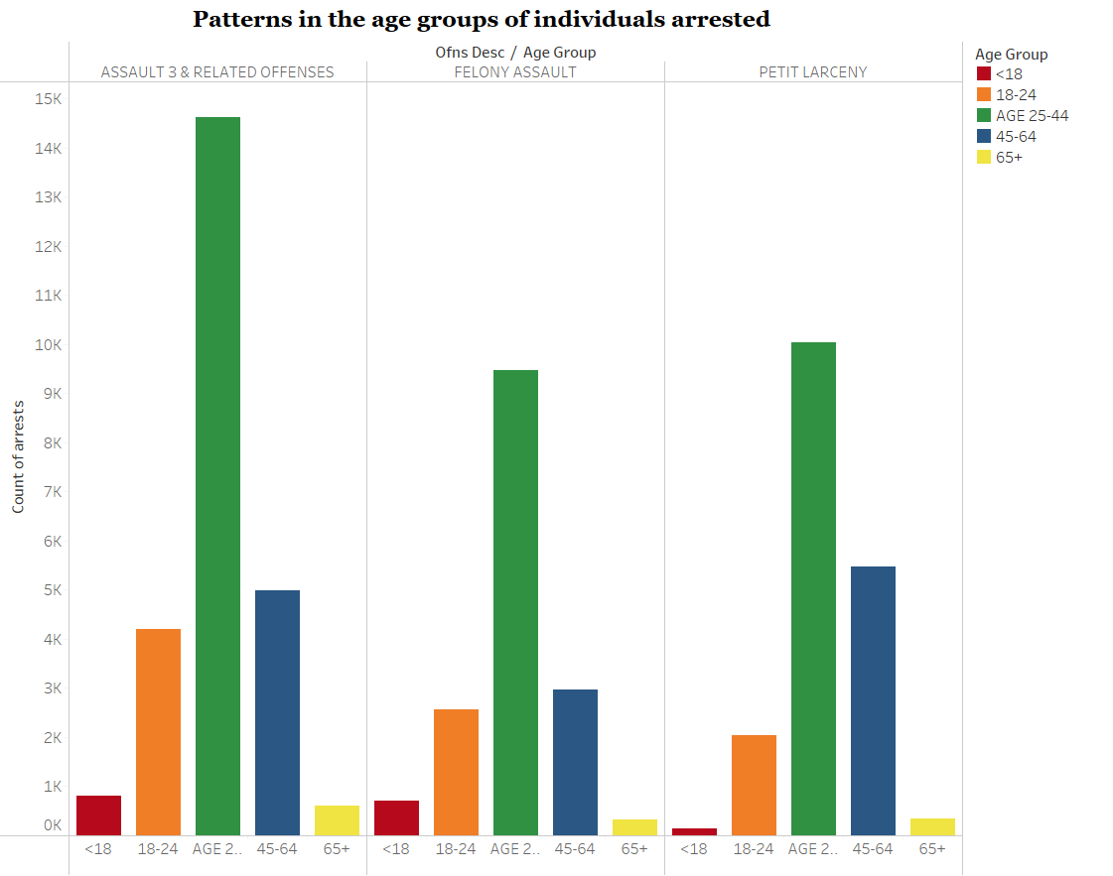
Analysis & Findings
3. Can we identify any patterns in the age groups of individuals arrested?
Youth (<18): Involved in Felony Assault (704) and Assault 3 & Related Offenses (798).
Seniors (65+): Victims of notable crimes in Felony Assault (318) and Assault 3 & Related Offenses (603).
Crime Peaks (25-44): Surge in crimes, including Felony Assault (9,463) and Petit Larceny (10,028).
Age Bracket Patterns: Analyzing varied offenses across age groups.

Slide 7
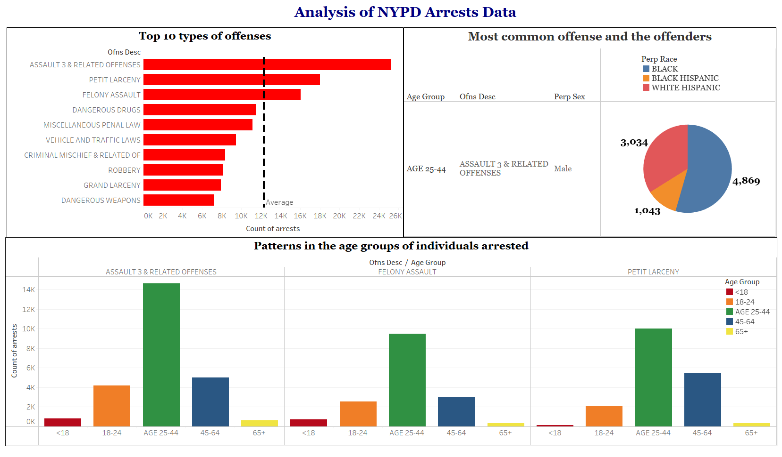
Dashboard

Slide 8

Conclusion
Finally, the examination of New York Police Department arrest data gives useful information about crime patterns, offender demographics, and age-related trends. This information is critical for making informed decisions, allowing law enforcement and lawmakers to create targeted policies that improve public safety and address specific concerns within the jurisdiction.

Slide 9
References
Dataset: source.
Statistical Analysis with help of Tableau: source.

Slide 10
Thank You

